Slide 1

Emergency Health I&IT Solutions & Technology Management Branch (EHSTMB) Orientation For New Staff
Ministry of Health
Ministry of Long-Term Care
GovTechON
Oct 2023

Slide 2











Summary Placemat
Shaping the Future in a Digital World Collaboration | Integration | Innovation | Modernization
Emergency Health Services
HSC Enterprise
Services
Information Technology Portfolio
CAD 5 Upgrade
Medical Triage Algorithm
911 Telephony Replacement
Voice Recording Integrations
Network, Infrastructure & Desktop
Backup Sites
SD-WAN Implementation
Public Safety Radio Network (PSRN)
Real-Time Data (RTD)
Incident Assignment/Low Acuity Dashboard
Mobile CAD (mCAD)
Central Integration Platform (CIP)
Automatic Vehicle Locator (AVL)
Unit Status View
Ambulance Dispatch Decision Support
Emergency Health Oversight and Compliance (EHOCM)
Geographic Information System (GIS)
Next Generation 911 (NG9-1-1)
EHS Primary Data Sharing & Services Agreement
COOP Plan Modernization
Modern Endpoint Management
IAMS Modernization
Security Operations
Disaster Recovery Strategy for SUS
KDC Rationalization
Software Refresh Plan/Datacentre Refresh Plan
IT General Controls (ITGC)
New Solutions in CMDB
MSAT
Workplace Culture, Employee Engagement & Tools
Pre-production Lab
Automated Testing Tools
Monitoring Tools
Newsletters
Branch Knowledge Centre
Strategic Roadmap
Security Monitoring
Increased Team Meeting Space
Staff Development & Education
Education Seminars
Virtual Branch Meetings
Patients & Providers Focused
Workplace
Culture
Digital
Government
Open
Communication
Human Centered Design
Agile & DevOps
Innovation

Slide 3
Branch Overview
The Emergency Health I+IT Solutions & Technology Management Branch (EHSTMB):
provides technologies to support 911 ambulance communications and emergency health regulatory and oversight;
plays a lead role within HSC on Operational Security, Business Continuity, Disaster Recovery and OPS Enterprise Solution initiatives.
Our large and mission critical operations supporting 9-1-1 ambulance communication results in close collaboration with ambulance dispatch operational managers, paramedic services, ORNGE, other first responders and hospital emergency departments to ensure communication technologies are running smoothly and are well integrated to support policies and programs under the Ontario Ambulance Act. EHSTMB plans for and implements new, best-in-class technologies that prioritize 9-1-1 calls and help dispatchers and first responders assure the right resources are assigned to the right place, with the right information, at the right time.

Slide 4

















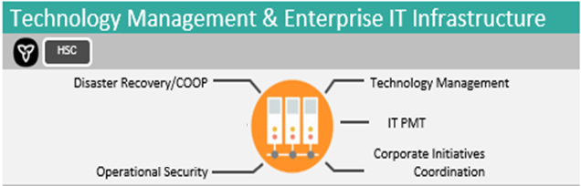
Emergency Health I&IT Solutions
1M
patients transported to medical facilities every year.
Utilizing 81,000 radio devices, including 170+ Satellite Radios, with 33,000+ Annual transmissions
Enabling 24/7 Land Ambulance Dispatch operations in Ontario with integrated, high-availability dispatch technologies, including Telephony, Computer Aided Dispatch (CAD), Medical Triage Algorithm, Real-Time Data for First Responders, Radio and Voice Recording solutions.
DID YOU KNOW?
There are 22 Land Ambulance Dispatch Centres operating in Ontario that receive over 2M medical
9-1-1 calls every year.
Communication
Communicating with 59 Paramedic Service organizations and 163 Hospital Emergency Departments
Voice Recordings
Police
Radio
9-1-1 Dispatch
Incident Coordination & Interoperability
ORNGE
2500+ Response Vehicles
Using over 1000
telephone lines
9-1-1 → Medical Call
GIS
CAD &
Medical Triage
Telephony
Fire
11,056 Paramedics
Supporting 12,560
Ambulance Communication Officers
Land Ambulance Dispatch
Real-Time Data Services
Dispatch
Transport
Tracking over 2000 emergency response vehicles
500+ Ambulance Bases
9-1-1 Caller
8 Regional Base Hospitals
Data Dashboards
& Analytics
How do we do it?
We support redundant systems to ensure 911 callers can reach our dispatch centres always
We record every voice interaction with callers and paramedics for quality assurance
We receive and integrate ambulance location satellite tracking data in real time
We provide Geographic Information System support to assure patients can be located
We enable communication with Emergency Department nurses on incoming patients and incidents
We provide systems that support Paramedic Service inspections annually for regulatory oversight
We provide systems that enable Paramedic certification applications and examinations
We provide BI and data analytics solutions that enable emergency health program performance management and oversight
mCAD
Paramedic Services
Satellite
Vehicle
Tracking
Medical Facility

Slide 5




EHSTMB
OPERATIONAL PLAN PILLARS
Employee Development
& Branch Culture
Technology and
Innovation
Operational Service
Excellence
Health System
Outcome Focused
The most important part of our branch is our team, our people, our work family. The skills and experience they bring, the passion they show for making the province a safer and better place, and their willingness to find innovative solutions to problems is one of the main reasons EHSTM can deliver on its commitments and responsibilities. We continue to strive to provide our team opportunities to grow, doing meaningful work in a diverse and inclusive environment. Our leadership team commit to continuing to have open and transparent dialogues and regular forums to share, listen and communicate.
EHSTMB is proud to be leaders in technology innovation, being in tune with jurisdictional & industry trends and best practices while balancing risks in complex mission critical environments. This fiscal we commit to continuing our multi-year journey by adopting and continuing to mature in several streams including additional cloud adoption, real-time data platforms, mobile apps, infrastructure and network design and modernization, and offering additional micro-services to the sector.
One of our core competencies is the ability to manage large and complex operations requiring 24/7 monitoring, response and support across the entire provincial geography. This requires layers of technology and business redundancy and contingency planning. We continue to strive for ongoing continuous improvement in areas such as life cycle management, vendor relationship management, service level monitoring and reporting as well as streamlining processes.
A guiding principle for the branch is that everything we do should be health system outcome focused. Whether this means delivering business value to frontline healthcare providers or back-office program administrators the end user and business program is the focus. This includes not only products or services but also in information management opportunities such as contributing to the ability to follow a patient journey, the ability to support situational awareness and evidenced based decision making.

Slide 6
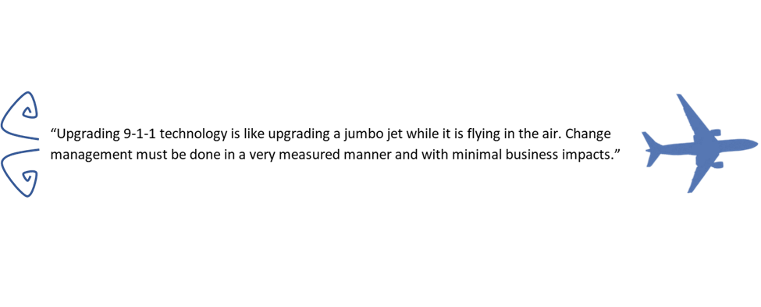
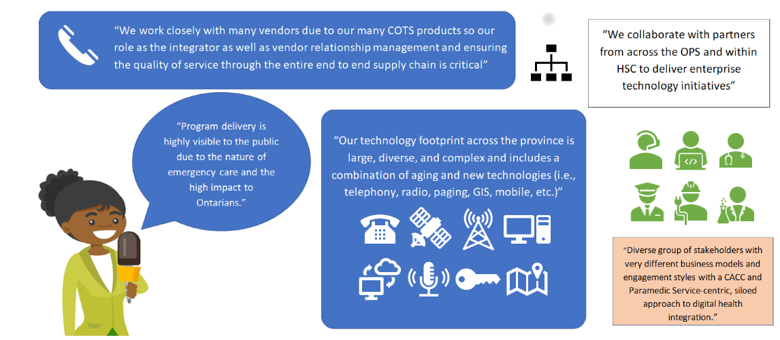
How Would We Describe the Work We Do?

Slide 7
Key Stakeholder Relationships
Ontario Provincial Police (OPP)
Telephone/Network Providers
Ontario Association of Fire Chiefs (OAFC)
PSRN Steering Committee
CRTC
Government Mobile Communications (GMCB)
NG911 - Emergency Services Working Group (ESWG)
ADIT
Terms of Reference
“Advisory to the Executive Director, Emergency Health Services and the Executive Lead, Health Services I&IT Cluster, providing a forum to establish strategic directions and assess impacts on sector-wide business and technology initiatives. ”
Provincially Run Central Ambulance Communications Centres (x13)
EHSTMB
ADIT – Integration Sub-Committee
Emergency Health Program Delivery Branch
Ambulance Dispatch Implementation Table (ADIT)
Ontario Association of Paramedic Chiefs
Emergency Health Services Division
56+ Paramedic Service Orgs
Co
-chair
Co-
chair
Emergency Health Regulatory & Accountability
Legend
Within Ontario Gov’t
External
Key Working Committees
ADIT - PSRN Zone Working Groups
Association of Municipalities of Ontario (AMO)
Ontario Health
Hospital EDs
Transfer Payment Central Ambulance Communications Centres (x8)
I&IT Vendor Community

Slide 8
Digital and Data Governance: Emergency Health
Emergency Health Services Directors Steering Committee (DSC)
Emergency Health Provincial Standards & Digital Optimization Committee
MOH PSRN Project
Telephony & Next Gen 9-1-1 Projects
MPDS Project
ADDS Project
EHOCM Project
Emergency Health Digital and Data Council
CAD Projects
Operational Intake Working Group / Governance
Digital and Data Capabilities Table
Strengthens enterprise data governance, enabling a consistent management of assets, timely access and development of robust analytics.
(May advise on data management/standards as related to individual initiatives)
SOLGEN-led PSRN Project Governance Structure (DSC, ESC, Deputy Council)
Project Governance
Product & Service Intake

Slide 9

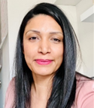

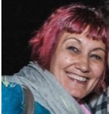
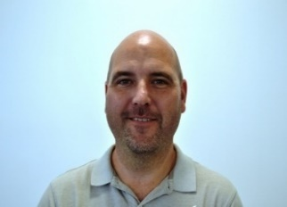

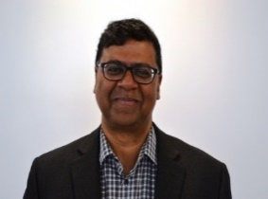
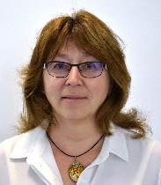

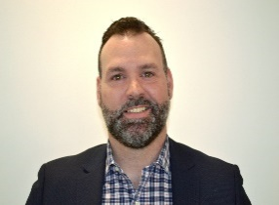
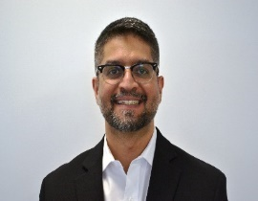
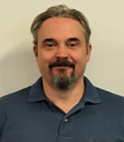
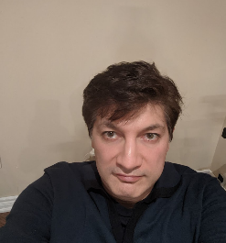
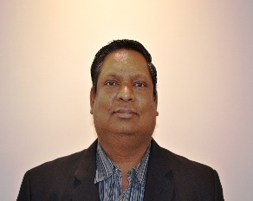
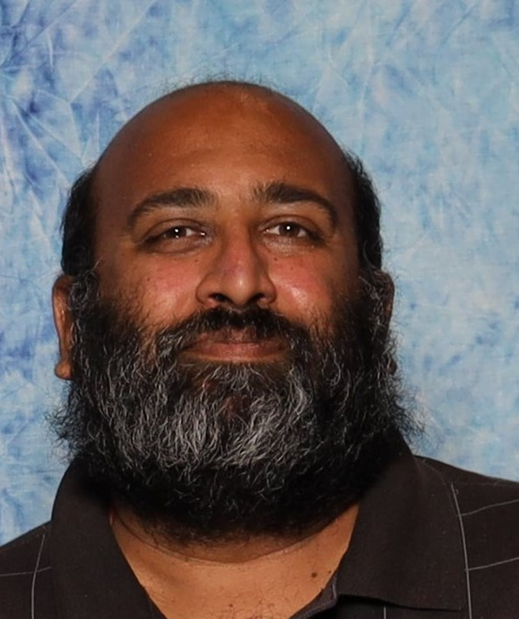
Management Team
Heather Berios,
Director
Avneet Bilkhu, A/Executive Assistant
Product & Services Portfolio
Daryl
Keating Sr. Mgr.
Greg Ross
Mgr.
Mirela Secosan Sr. Mgr.
Branch Operations
IT Projects
Fabio Torresan Mgr.
Program & Portfolio Management
Program & Portfolio Management
Solutions Design
Desmond D’Souza
Sr. Mgr.
Lena Rechetova. Mgr.
Erlend Sobec Mgr.
Jayson Moon
Mgr.
Vacant
Mgr.
Design, Development & Applications
Solutions Design
Solutions Development & Quality Assurance
Applications 1
Applications 2
Ali Jessa Sr. Mgr.
Lance RissmanMgr.
Val ShafieianMgr.
Daniel Mohan
Mgr.
Dharmesh Patel
Mgr.
Operations, Infrastructure & Telecommunications
Infrastructure
Site Support - East
Site Support - West
Monitoring, Surveillance & Encryption

Slide 10
Director’s Office
Heather Berios,
Director
Avneet Bilkhu, A/Executive Assistant
Communicates Branch strategies and objectives
Manages the planning and operation of ministry and cluster infrastructure, IT solutions and services
Creates a work environment that supports and promotes employee engagement and inclusion
Ensures all EHSTMB Units understand our financial position and strategies
Provides services through 4 core areas of excellence:
Product & Services Portfolio
Program & Portfolio Management
Design, Development & Applications
Operations, Infrastructure & Telecommunications

Slide 11
Product & Services Portfolio
Daryl
Keating Sr. Mgr.
Product & Services Portfolio
The Product & Services Portfolio Team is responsible for building ongoing partnerships with internal and external stakeholders to meet business and IT objectives. The Team operates the ‘EHS Technology Services Intake’ function, defines business requirements, standards and strategies for IT product and service development, and develops business cases to evolve solutions to meet sector needs. It leads on data integration planning with sector stakeholders and contributes to the development of sector data standards and governance. The team also leads on IT issues management and executive level support. Team activities include business analysis, data integration design, agile team building, project management, stakeholder governance and corporate communications.

Slide 12
Mirela Secosan Sr. Mgr.
Program & Portfolio Management
Program & Portfolio Management
The Program & Portfolio Management Team plays a crucial role within an organization by overseeing and orchestrating the strategic execution of projects and initiatives. This team is responsible for aligning the company's goals and objectives with its project portfolio, ensuring that resources are allocated efficiently, and that projects are delivered on time and within budget. They employ a holistic approach to project management, focusing not only on individual projects but also on how they collectively contribute to the organization's overall success. By prioritizing projects, managing risks, and optimizing resource allocation, the Program & Portfolio Management Team helps the organization navigate complex challenges and achieve its strategic vision, ultimately driving growth and innovation. Their work involves continuous evaluation, adaptation, and decision-making to ensure that the portfolio remains aligned with evolving business needs and market dynamics.

Slide 13
Branch Operations
Branch Operations
Fabio Torresan A/Mgr.
The Branch Operations Team is responsible for providing branch administrative and operational support including HR, financial, project oversight, procurement and operational management for EHSTMB. The Team also provides fiscal oversight, budgetary tracking, and corporate financial report.

Slide 14
IT Projects
IT Projects
Greg Ross
Mgr.
The IT Project Portfolio Team is responsible for managing and supporting IT Projects that span the entire cluster from external stakeholders like ITS, SUS and GSIC.
IT Operational Security Team provides operational security support and compliance for the Cluster, including incident response, reporting, SSL certificates, firewall rules and, liaison with Cyber Security Division.
Disaster Recovery Services Team manages the DR services for the cluster, including; design, planning, testing, and cost management. This includes the yearly DR exercise co-ordination work with ITS, SUS, and HSC.
Continuity of Operations Planning Team manages the clusters COOP plan as well as acts as the co-ordination point for activation of the COOP. This includes yearly updates and submission of the COOP to the ministry.

Slide 15
Desmond D’Souza
Sr. Mgr.
Design, Development & Applications
Design, Development & Applications
The Design, Development and Applications Team is responsible for the planning, analysis, design/architecture, enhancement, development/testing and implementation of business solutions to meet current and emerging program needs.
The Team is also responsible for the integration of all the applications and technology stack. This is ensured by keeping the technology roadmap up-to-date and meeting future business needs.

Slide 16
Lena Rechetova. Mgr.
Design, Development & Applications
Solutions Design
The Solution Design Team provides the design and architecture for MOH solutions, evaluation of technology proposals against existing investment and future trends/directions. The planning, design and integration aligns on HSC technology road-mapping and strategic planning. Solution Design is a critical aspect in the delivery of any project, whether for Life-cycle planning or transformation with the sector. The Technology Architects ensure that technology used meets 911 requirements, is fit for purpose and meets industry standards.
The team is responsible for strategic work, such as adoption of GoCloud technologies for the EHS program area, Next Generation 9-1-1 technologies and integration between CAD, Call Taking, Voice Recording, and GIS solutions.
The team is responsible for tactical work, such as creating architecture for ArcGIS, AVL Aggregator, AQUA, MCAD, CIP and other the EHS solutions.
The team works very close with developers, infrastructure specialists, application SMEs and others at the Branch, as well as collaborates with ITS and other OPS divisions.

Slide 17
Design, Development & Applications
The Solutions Development & Quality Assurance Team ensures rigour around development and quality products, processes and it guarantees that the business needs are met through robust systems development and quality assurance methods.
The primary goal of this team is:
to get the products out the door but with quality as a driver (to meet 911 requirements)
to ensure Software development is done in a standardized, robust way and is easily deployed and maintained with quality in mind.
Erlend Sobec Mgr.
Solutions Development & Quality Assurance

Slide 18
Design, Development & Applications
The Applications 1 Team are responsible for providing 24/7 service operations for Ontario for Land Ambulance Services with applications, middleware, and databases. The most significant application being the Computer Aided Dispatch (CAD) tool. The majority of other applications are either provided as functions within this tool or are tightly integrated with CAD.
The team provides upgrade and operational support for the following:
Geographic Information Systems that provides digital mapping, compilation of comprehensive Ontario maps for Land Ambulance Services
Core dispatch applications, including CAD, Medical Triage (DCPI II, MPDS), AVL, CAD 2 CAD, Call Close, Marvlis, CAD North
The Applications 2 Team are responsible for providing service operations for Ontario for Land Ambulance Services for 24/7 data service applications. Specific applications support are:
ADRS, Mobile-CAD (mCAD), Real-time Dashboards, Data Services, i.e. CIP, Simultaneous Notifications
Jayson Moon
Mgr.
Applications 1
Desmond D’Souza, A/Sr. Mg
Vacant
Mgr.
Applications 2

Slide 19
Ali Jessa Sr. Mgr.
Operations, Infrastructure & Telecommunications
Operations, Infrastructure & Telecommunications
Maintain, integrate and ensure currency of I+IT solutions for the Emergency Health Services Division, paramedic services and hospital emergency departments:
Maintain high-availability system solutions to support a complex 24/7/365 emergency service operations
Respond to a high volume of service requests to support 911 operations and business continuity plans
Solution version upgrades to enable ongoing system integration, improve functionality, and assure cost effective maintenance and support
Lifecycle management of technology stack including ongoing patching requirements
Large COTS vendor relationship, service level and contract management
Services include but not limited to:
Large footprint of infrastructure, network and desktop services across over many locations including 22 dispatch centers, backup centers, regional training centers and our lab. Telecommunication infrastructure is also in 500+ ambulance bases, 150+ hospital emergency departments and 2500+ response vehicles across the province.
Computer Aided Dispatch (CAD) system - 911 call taking and dispatching functions
Dispatch centre and first responder telecommunication systems including 911 telephony, trunked and satellite radio support
Voice Recording solutions for investigations and quality assurance
Suite of solutions to support emergency health regulatory and oversight functions including reporting
EHSTMB operational teams respond to approximately 7500+ service requests and incidents annually.
Dharmesh Patel
Mgr.

Slide 20
Operations, Infrastructure & Telecommunications
The Infrastructure Team provides the following services:
Hardware Lifecycle Management for server, desktop, and network devices
Software Lifecycle Management for infrastructure software and operating systems
Security Management including patch management, vulnerability management tracking and reporting
IT Infrastructure Operations for servers, backup, desktops, network, storage, infrastructure applications to ensure availability for application operations including incident response, maintenance services, project and change implementations, and major upgrades
Hardware Management including health monitoring, firmware management, and configuration management
Facilities Management including environmental monitoring/response, integration with building facilities, planning and implementation for HVAC, power systems, cleaning, security access systems, health/safety compliance and audit.
Network Management for switches, firewalls, routers, WAN circuits, DNS and IP management.
Service Intake/Project support to deliver the future of hosting in line with business priorities and operational plans.
Our services are utilized across 22 ACC server rooms, 7 training centres and 1 centralized data centre in Toronto, and 2 DR facilities in Barrie and Hamilton supporting critical services such as Computer Aided Dispatch, Telephony and Radio. We provide Operational Support for the above services listed 7x24x365 and are the subject matter experts contributing to service requests, Service intakes, enhancements, service improvements and projects.
Lance RissmanMgr.
Infrastructure

Slide 21
Operations, Infrastructure & Telecommunications
Val ShafieianMgr.
The Site Support & Operations (East) Team delivers services, 24/7, across Eastern Ontario for Ontario Land Ambulance Bases, Communication Dispatch Centres and Hospitals by providing and supporting:
911 telephony technology and NG 911 Operational and projects
Service Management oversight, monitoring and continuous improvement
Enterprise-wide changes and legislative updates
Vendor managed service delivery
Tier 2 and 3 onsite support for all integrated technologies
We provide Operational Support for the above services listed 7x24x365 and are the subject matter experts contributing to service requests, Service intakes, enhancements, service improvements and projects.
The Site Support & Operations (West) Team 24/7 field support across Western Ontario for Ontario Land Ambulance Bases, Communication Dispatch Centres and Hospital by providing and supporting:
Two-way push-to-talk Radio Technology and user gear
Radio paging and communication infrastructure
Mobile Satellite Air-Time Radio Communication (MSAT)
Digital Voice Recording and Retrieval (DVRR)
Tier 2 and 3 onsite support for all integrated technologies
We provide Operational Support for the above services listed 7x24x365 and are the subject matter experts contributing to service requests, Service intakes, enhancements, service improvements and projects.
Site Support - East
Daniel Mohan
Mgr.
Site Support - West

Slide 22
Operations, Infrastructure & Telecommunications
Dharmesh Patel
Mgr.
Monitoring, Surveillance and Encryption Team This newly formed unit will be located at our Hamilton CACC location, servicing Ontario Communication Dispatch Centres and its Paramedic Services.
The unit will be responsible for providing services 7X24X365 for the:
enabling & disabling of radio equipment as required in support of user requests.
actioning of alerts detected via Monitoring & Surveillance Tools and Dashboards by:
performing triage and executing remote troubleshooting or initiating support from vendor and internal support providers
triggering Business Continuity escalations
Monitoring, Surveillance & Encryption

Slide 23
PRODUCT AND SERVICE ROAD MAPS

Slide 24

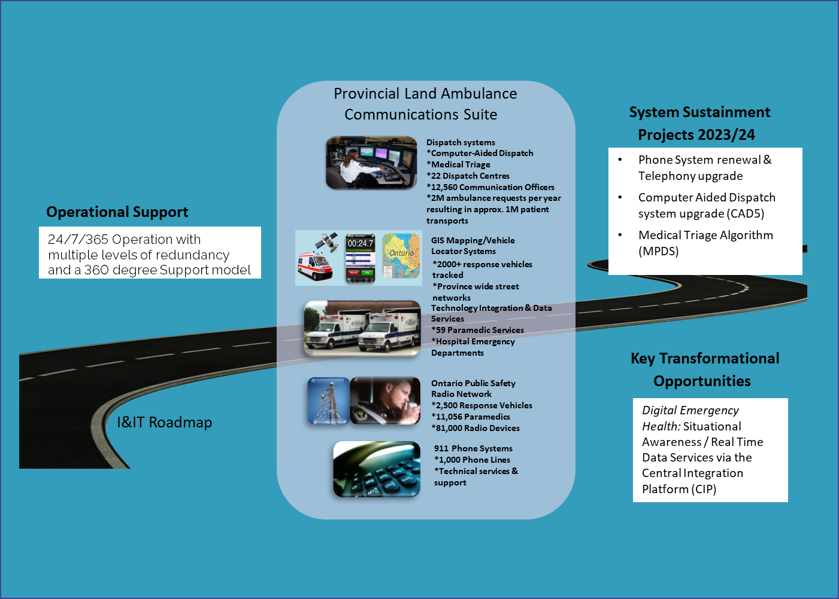

Slide 25

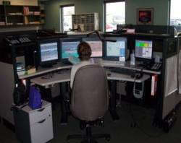
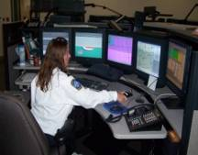
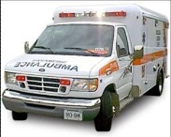
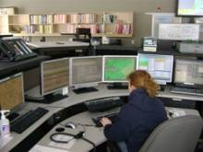



External Partners
MOH
External Partners
Public Safety
Answering Point (PSAP)
22 Central Ambulance
Communications Centers
500 + Ambulance Bases
Call Taker
Paging Signal
150 Provincial
Paging Sites
2500 + Provincial Response Vehicles
Dispatcher
Telephone Company
172 Provincial
FleetNet Sites
600 Hospitals & Clinics
Bell Mobility FleetNet Radio Network Switch (4 in Province)
Notes:
Speaker = Liz
Ambulance not just about Emergencies

Slide 26
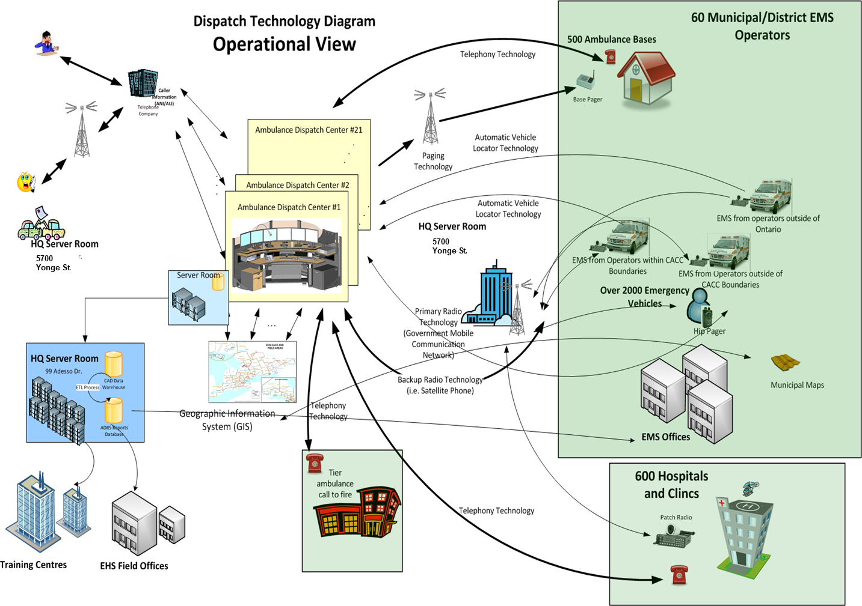
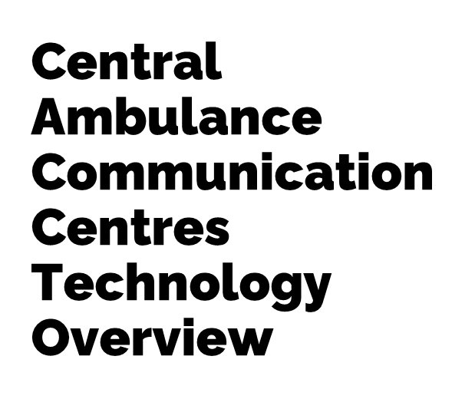

Slide 27
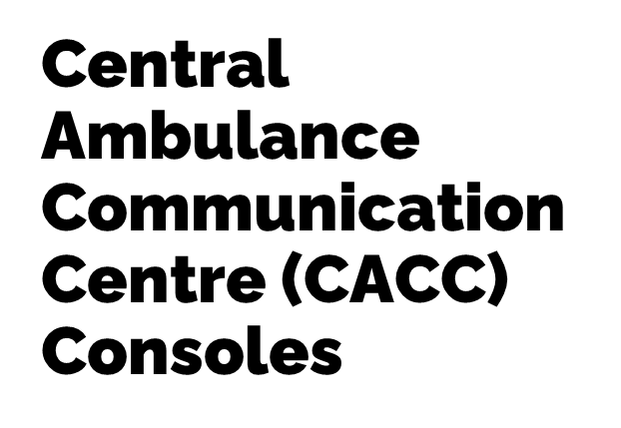
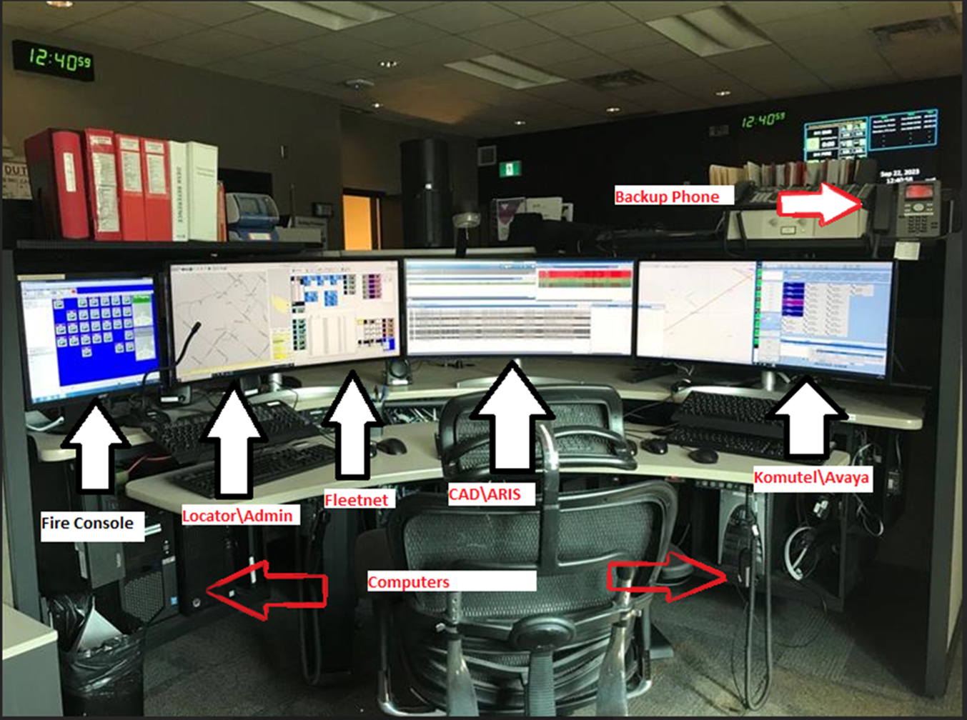

Slide 28
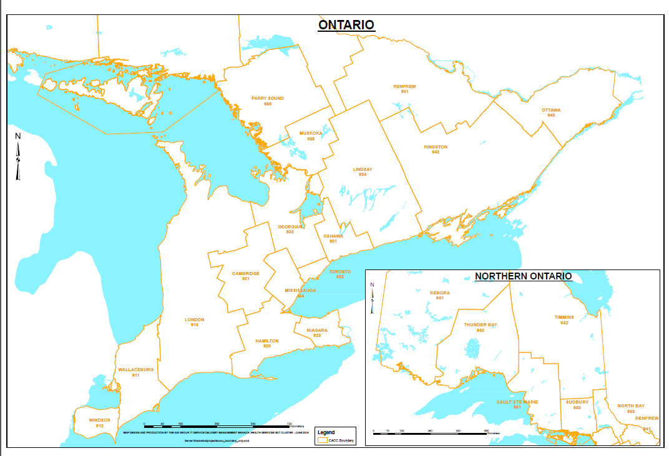
Ambulance Call Centres Locations

Slide 29
Incidents and Service Intakes
Incidents are submitted to the Service Desk where they are entered into eSMT.
Incidents are then triaged by the QC team and assigned to staff.
Service Intakes are request that are made by the business for additions and changes.
Service Intakes can be simple or complex. Simple SI’s are directly assigned, complex SI’s are triaged by management before being assigned.
Executive highlights are added to the SI to provide line of sight for the business.

Slide 30
Appendicies

Slide 31
Appendix A: Mandatory Courses for All OPS
As a new employee to the OPS, you are required to complete the following courses. These courses are designated as mandatory based on legislative requirements, policy or corporate directives governing OPS operations. For further information, please visit EHSTMB SharePoint Site “Knowledge Centre” at EHSTMB - Knowledge Centre (sharepoint.com)

Slide 32
Appendix B: Additional Resources
EHSTMB – Flexible Work Arrangement
https://intra.ontario.ca/ops/imanage-support-flexible-work
Health Services I&IT Cluster (HSC I&IT)
https://intra.ontario.ca/hsc
Client/ Program Area- Direct Services Division (DSD) & Emergency Health Services Br (EHSB)
https://intra.ontario.ca/mohltc-dsd
Inside IT- I&IT Intranet site
https://intra.ontario.ca/?utm_source=desktop_icon&utm_campaign=desktop_icon
HSC Project Management Office (PMO)
PMO
Ministry of Health & Long-Term Care (MOHLTC)
https://intra.ontario.ca/mohltc/health-about-us
Instructions on Utilizing Ministry Vehicles (DH to provide link)

Slide 33
Appendix C: Additional Resources
Tips on your achieving success as an OPS employee:
OPS Employee Orientation
Doing the Right Thing
https://intra.ontario.ca/mohltc/mohltc-employee-orientation
Health and Safety Services
https://intra.ontario.ca/cehsw-hss
Occupational Health & Safety
https://intra.ontario.ca/ops/ohs
Workplace Discrimination & Harassment Prevention
https://intra.ontario.ca/ops/hr-workplace-discrimination-and-harassment-prevention-wdhp-services

Slide 34
Appendix D: Acronyms
For a list of frequently used acronyms in EHSTMB, please visit the EHSTMB SharePoint Site “Links” page at:
EHSTMB - Links (sharepoint.com)

